Slide 1
Feature Optimization Based Heart Disease Prediction using Machine Learning Presented By, Saran Jaya Thilak Eldho Paulose Binnies P Benny Arjun Raj C

Slide 2
Table of Contents
01
02
03
04
05
Introduction
Methodology
Data set
06
Conclusion
Confusion Matrix and Accuracy
Application of Genetic Algorithm

Slide 3
Introduction
According to WHO, Cardiovascular diseases(CVD) are the number 1 cause of death globally(17.9 million lives per year).
CVDs are a group of disorders of the heart and blood vessels.
It include coronary heart disease, cerebrovascular disease, rheumatic heart disease and other conditions.
4 out of 5CVD deaths are due to heart attacks and strokes, and one third of these deaths occur prematurely in people under 70 years of age.

Slide 4
Literature Survey
Title | Author | Used Method
Heart disease diagnosis using predictive data mining | Venkatalakshmi B Shivsankar MV | Random Forest, Naïve Bayes are applied to predict the heart diseases. Naïve Bayes model achieved more accuracy than Random forest.
Heart disease prediction using machine learning algorithms | Jindal H Agrawal S Khera, R Jain R | Logistic regression, KNN and Random forest are used for prediction of heart disease. Highest accuracy of 88.52% was achieved using KNN.
Heart Disease Diagnosis and Prediction Using Machine Learning and Data Mining Technique | R. Subramanian | Predicted heart disease using 120 layers’ deep neural network. Performance of the model is optimal. But model-training time is high and require large datasets.

Slide 5
Methodology
Several studies on heart disease have been carried out by using machine learning techniques; but the performance of these models are not optimal.
Therefore, we introduce a new model. Firstly, K-Nearest Neighbor (KNN), Naive Bayes, and Decision tree were applied to the dataset for the prediction of heart disease.
The performance of these models is evaluated by using 3-fold cross validation and highest average accuracy of 87.78% is obtained by the Naive Bayes.
Further, we have applied a genetic algorithm to the dataset to optimize the features.
After optimization, the highest average accuracy of 96% is achieved by the Naive Bayes.

Slide 6
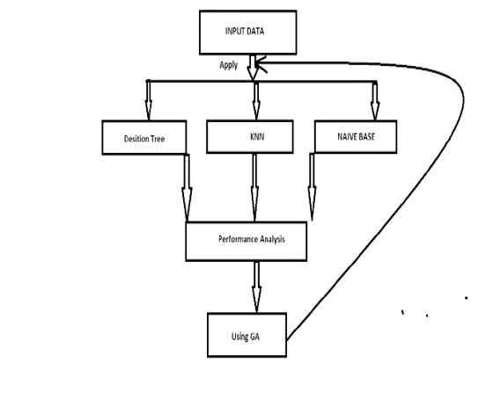
FLOW CHART

Slide 7
Algorithms and Techniques Used
The project will be running various classification algorithms on the dataset provided and based on the data given we will be deriving the required output.
It is not possible to conclude which one is superior to the other.
It depends on the application and nature of the available data set.
The figure represents how the sample model of the project will help us arrive at the solution.
A genetic algorithm is introduced to improve the accuracy.

Slide 8
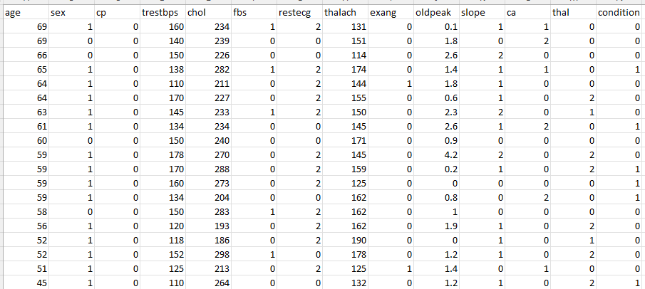
Data set
This study utilizes experimental data of 303 candidates
gathered from UCI Machine Learning Repository. The
dataset is open access data repository, and it can be used for the analysis of the heart disease.

Slide 9
Libraries used
numpy: To work with arrays
pickle : To serialize
pandas: To work with CSV files
matplotlib: To create charts using pyplot, define parameters
seaborn : Data visualization like Heat map
train_test_split: To split the dataset into training and testing data
sklearn: to work with classification algorithm

Slide 10
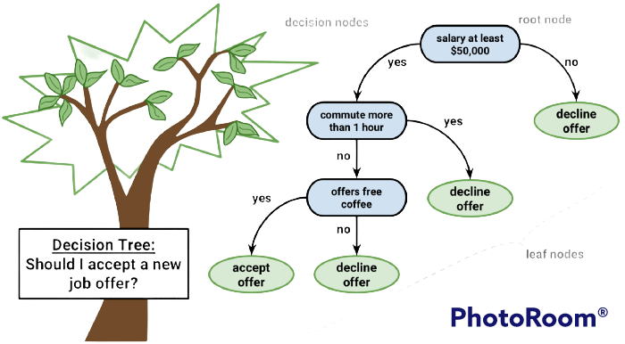
Decision Trees
Decision tree builds classification or regression models in the form of a tree structure.
Each time a rule is learned, the tuples covered by the rules are removed.
This process is continued on the training set until meeting a termination condition.
• Powerful and popular tools for classification and prediction
An over-fitted model has a very poor performance on the unseen data even though it gives an impressive performance on training data

Slide 11
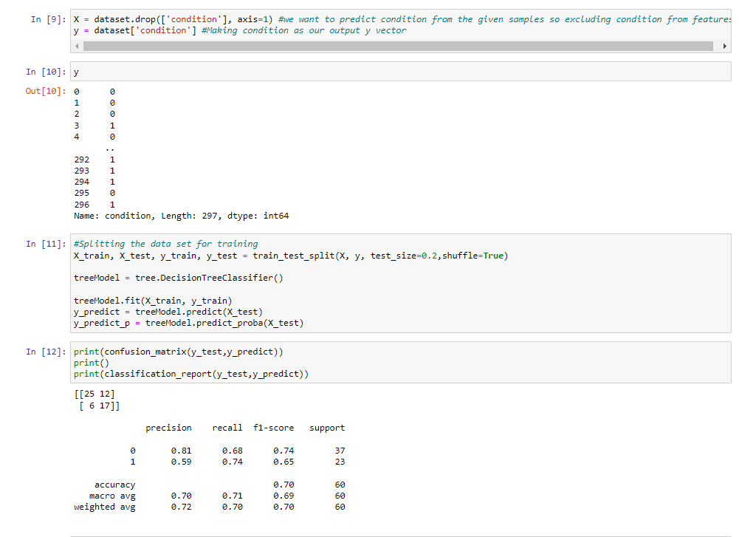
Sample Code-Decision tree

Slide 12
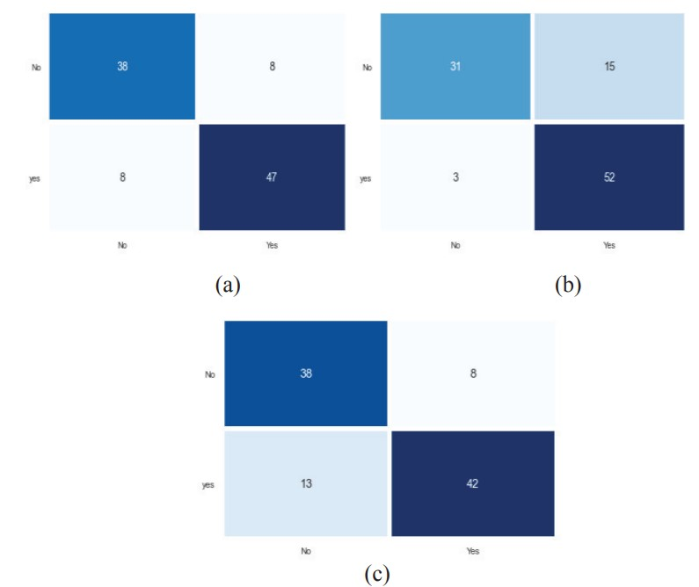
Confusion matrix (Decision Tree)

Slide 13
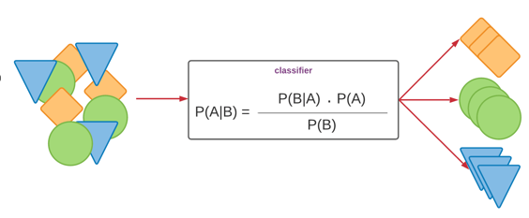
Naïve Bayes
Based on Bayes’ Theorem with an assumption that all the features that predict the target value are independent of each other.
While in real-life data, features depend on each other in determining the target, this is ignored by the Naive Bayes classifier.
• Efficient in terms of CPU and memory consumption
• Requires a very small amount of training data and time

Slide 14
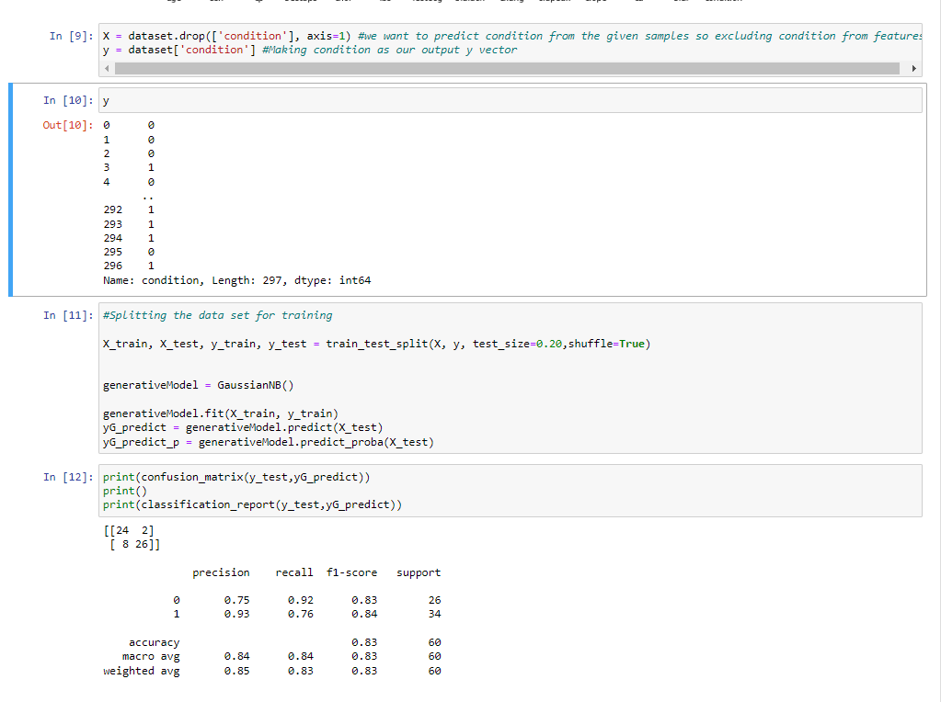
Sample Code-Naive Bayes

Slide 15
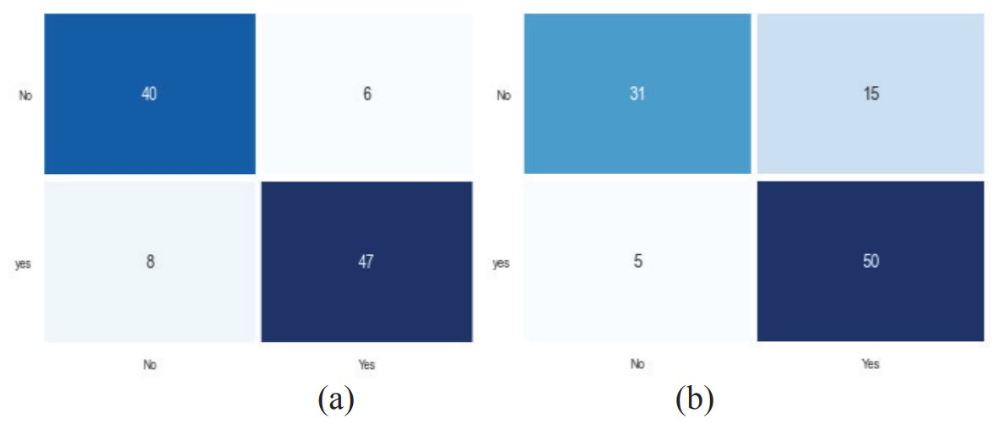
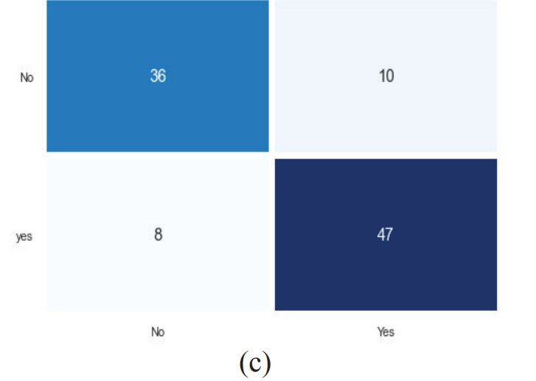
Confusion matrix (Naive Bayes)

Slide 16
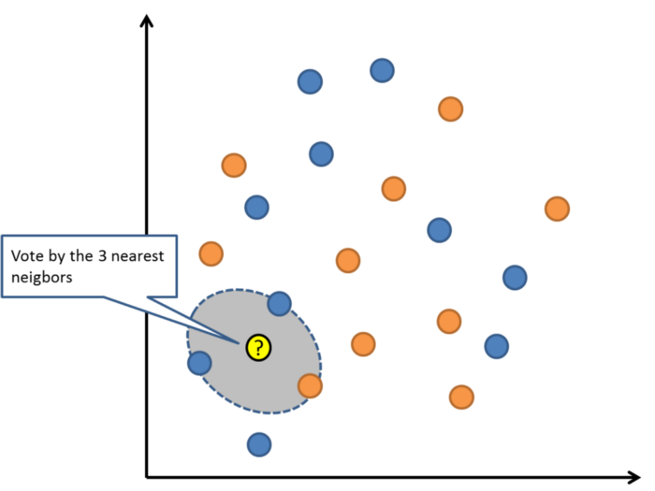
K Nearest Neighbor
The algorithm which stores all instances corresponds to training data points in n-dimensional space.
When an unknown discrete data is received, it analyzes the closest k number of instances saved (nearest neighbors)
It returns the most common class as the prediction and for real-valued data, it returns the mean of k nearest neighbors.
• Very accurate and Simple learning

Slide 17
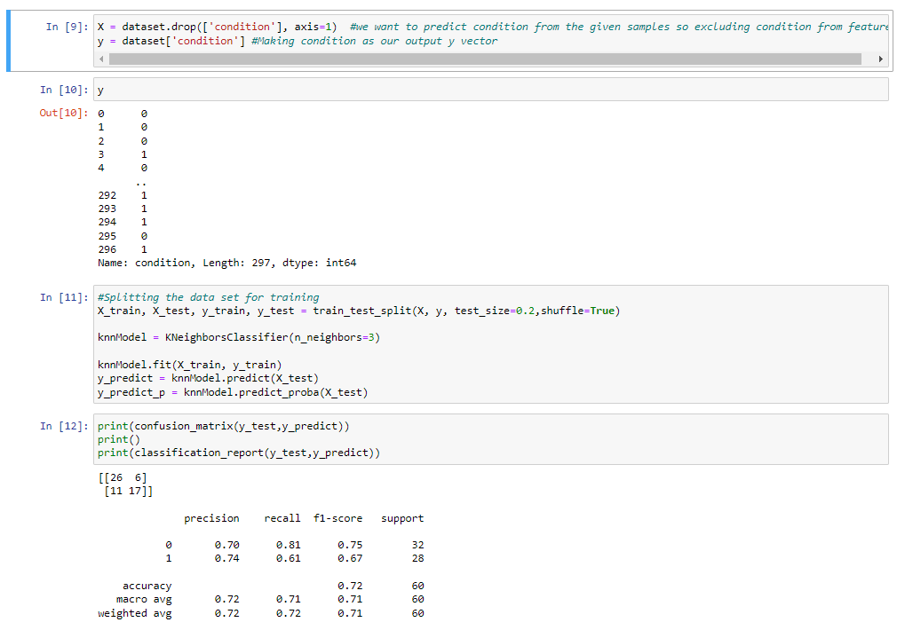
Sample Code-KNN

Slide 18
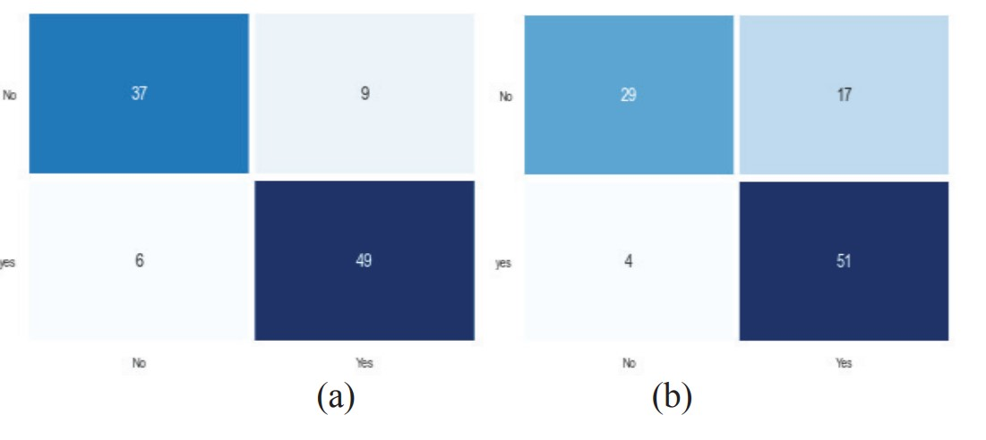
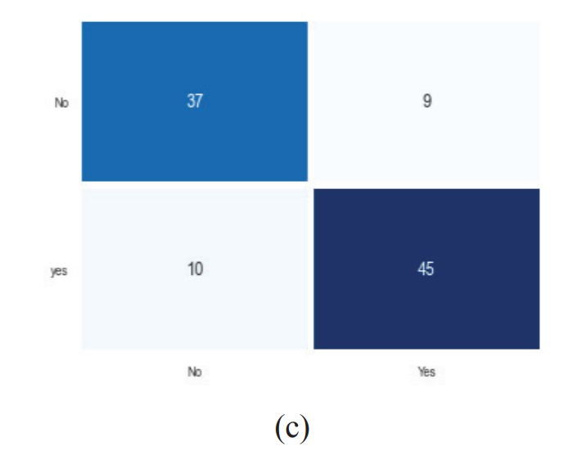
Confusion matrix (KNN)

Slide 19
Performance
METHOD | AVG. PRECISION | AVG. RECALL | AVG. F1 SCORE | AVG. ACCURACY
KNN | 86.3 | 85.3 | 85.3 | 85.8
NAÏVE BAYES | 85.3 | 88.3 | 86.3 | 87.9
DECISION TREE | 87.3 | 87.3 | 87.3 | 86.8

Slide 20
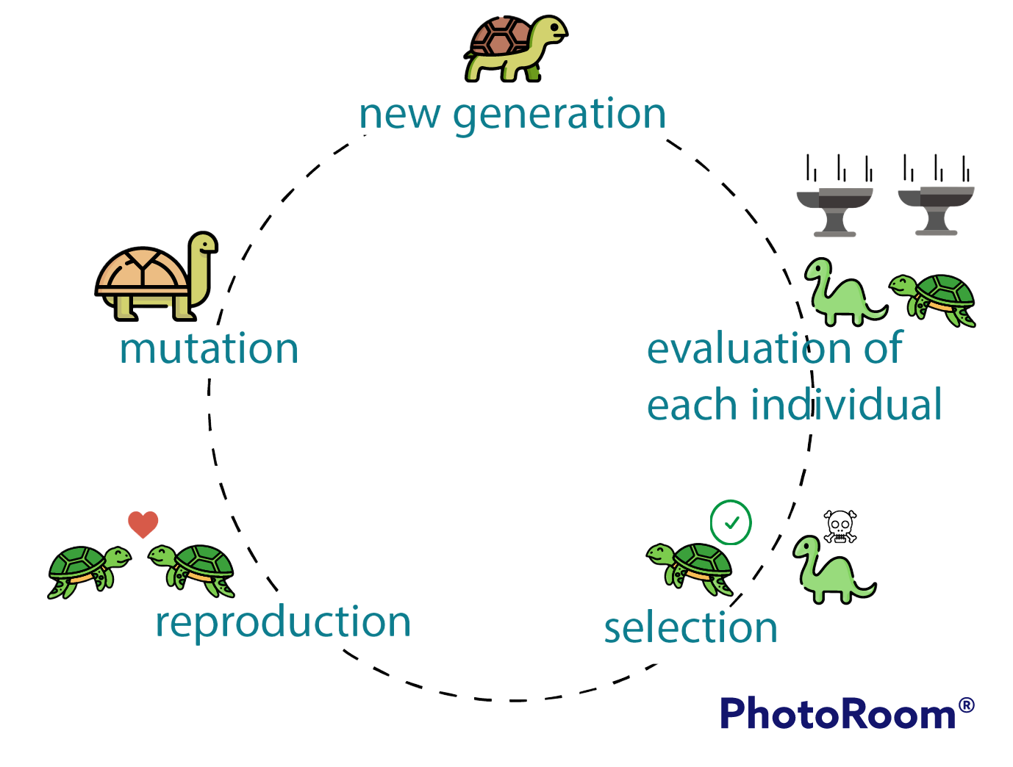
Genetic Algorithm
The genetic algorithm was created by John Holland and De Jong.
It is based on Charles Darwin's theory of natural evolution and inspired by genetics and natural selection.
In natural selection, the fittest entities are selected from the population for the next generation.
This process is repeated until a population of the fittest is found.

Slide 21
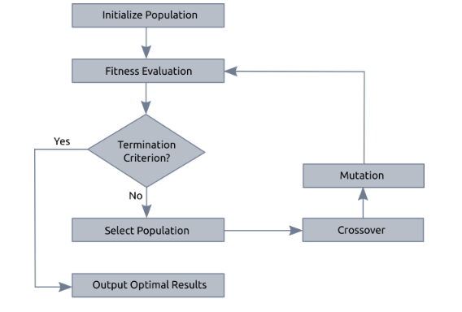
Application of GA
Selected dataset is loaded
Apply genetic algorithm on attributes of the data set.
Rank all the Attributes based on their feature importance value.
Select the subdivision of high-ranked attributes.
Apply classification algorithms on the subset of selected attributes to maximize accuracy.

Slide 22
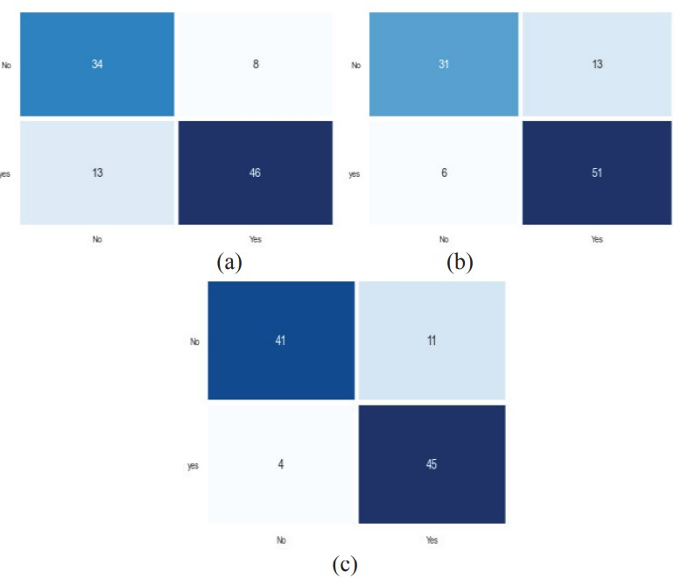
Confusion matrix (Decision Tree)

Slide 23
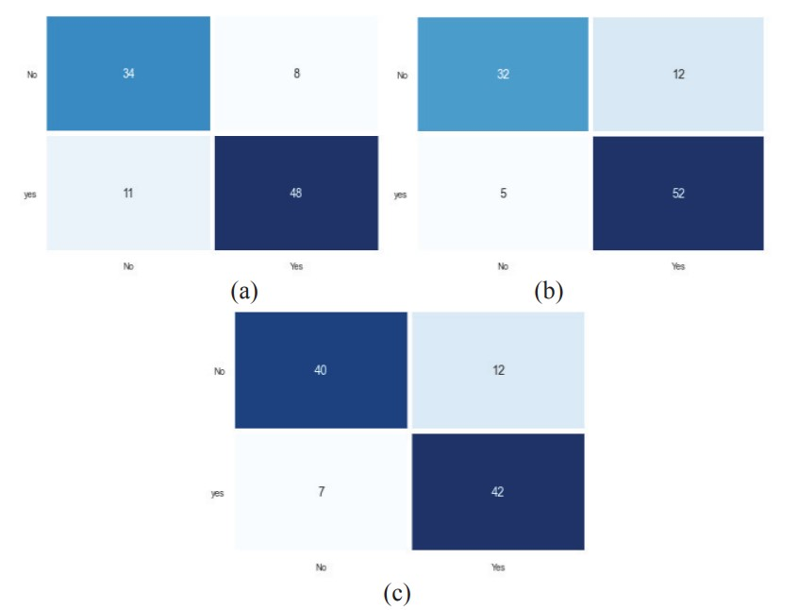
Confusion matrix (KNN)

Slide 24
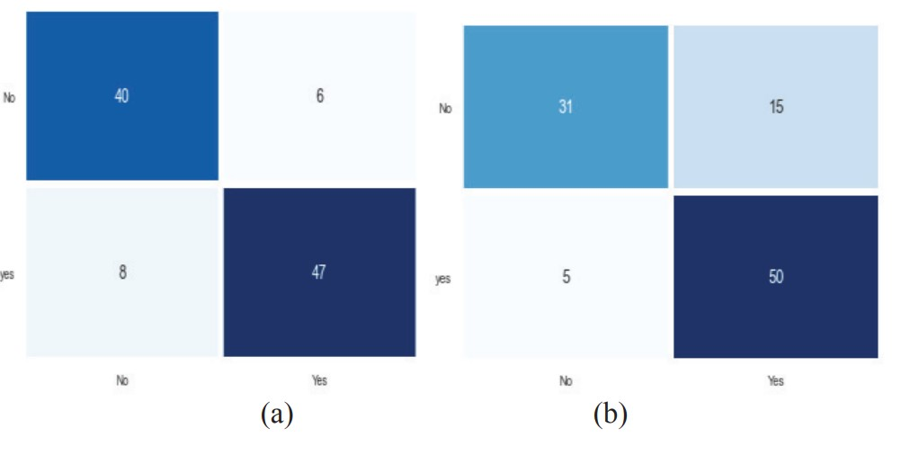
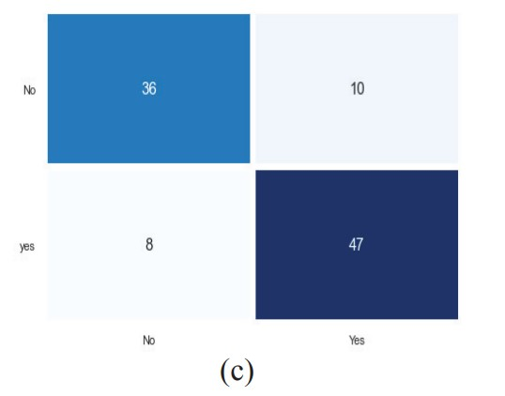
Confusion matrix (Naive Bayes)

Slide 25
Performance
METHOD | AVG. PRECISION | AVG. RECALL | AVG. F1 SCORE | AVG. ACCURACY
KNN | 85.3 | 85.3 | 85.3 | 81.8
NAÏVE BAYES | 95.3 | 96.3 | 96.3 | 96.0
DECISION TREE | 88.3 | 87.3 | 88.3 | 86.8

Slide 26
Conclusions
The UCI dataset contain 14 attributes and they used to train and classify Decision tree, KNN and Naïve Bayes.
Naïve bayes achieved highest accuracy of 87.9% using 3-fold cross validation and this achieved accuracy is not satisfactory.
Therefore, a feature optimization technique GA has been applied.
After optimization of features again these models are trained. The Naïve bayes model achieved accuracy of 96% and this result is quite satisfactory for the heart disease prediction.

Slide 27
References
Zriqat IA, Altamimi AM, Azzeh M “A comparative study for predicting heart diseases using data mining classification methods”. Scientific reports:1704.02799. 2017 Apr 10.
Muhammad Y, Tahir M, Hayat M, Chong KT “Early and accurate detection and diagnosis of heart disease using intelligent computational model”. Scientific reports. 2020 Nov 12;10(1):1-7.
Alarsan FI, Younes M. “Analysis and classification of heart diseases using heartbeat features and machine learning algorithms”. Journal of Big Data. 2019 Dec;6(1):1-5.
Saxena K, Sharma R. “Efficient heart disease prediction system”. Procedia Computer Science. 2016 Jan 1;85:962-9
Pattekari SA, Parveen A. “Prediction system for heart disease using Naïve Bayes”. International Journal of Advanced Computer and Mathematical Sciences. 2012 Jun 12;3(3):290-4.

Slide 28
Thanks
Do you have any questions?

